Slide 1
Analysis of average time across sessions as a proxy for a student's genuine participation in the game
DataFest 2022
RJ Krimetz, Yoon Park

Slide 2
Introduction

Slide 3
Data Preparation

Slide 4
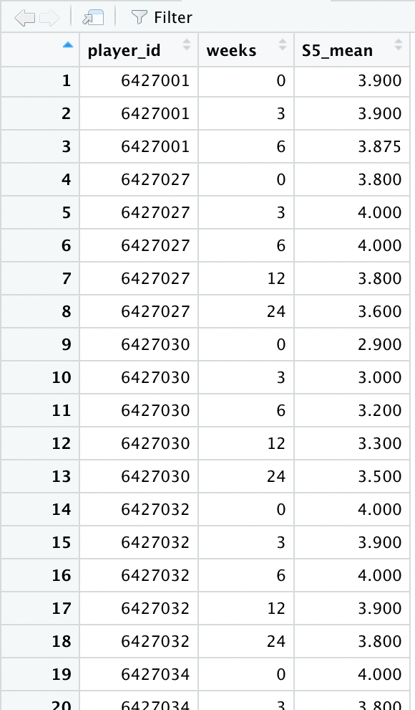
Labelling each players whether they improved or not
Data Preparation

Slide 5
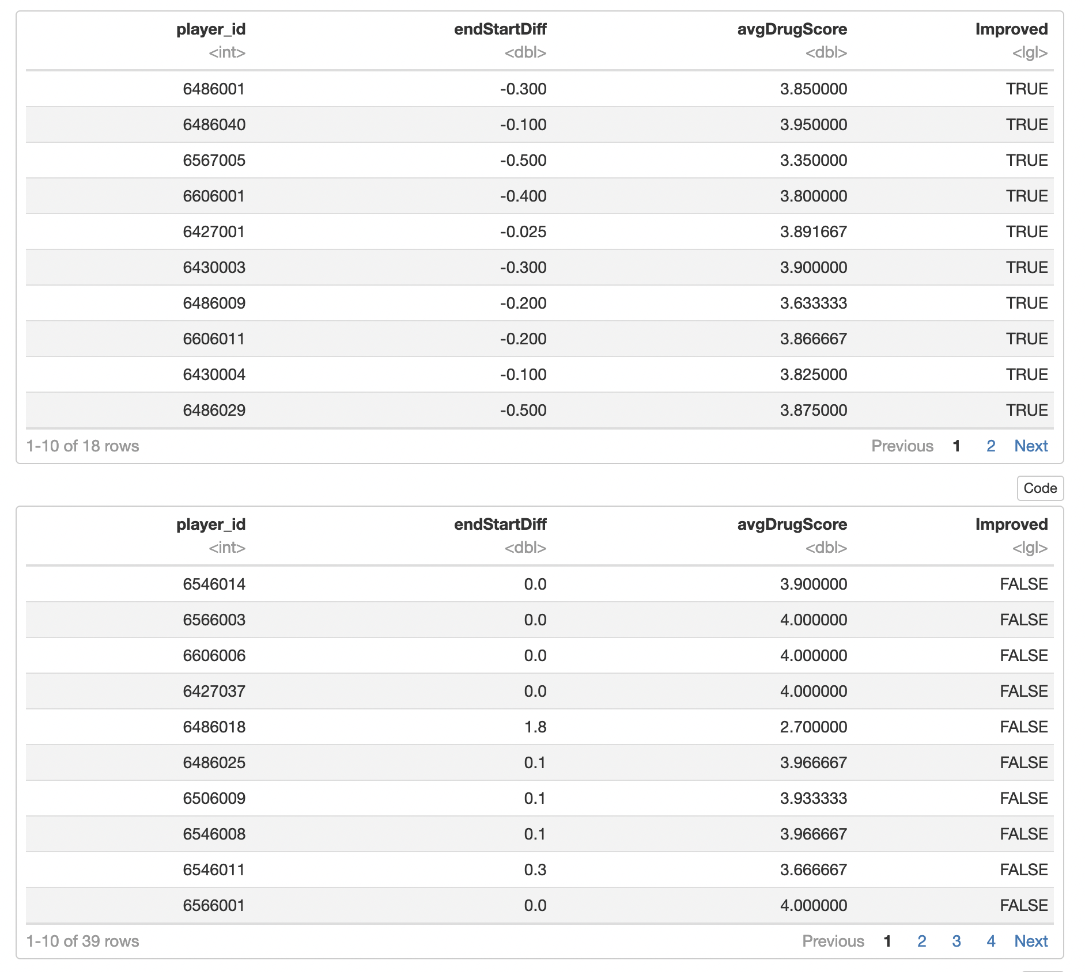
Labelling each players whether they improved or not
Data Preparation

Slide 6
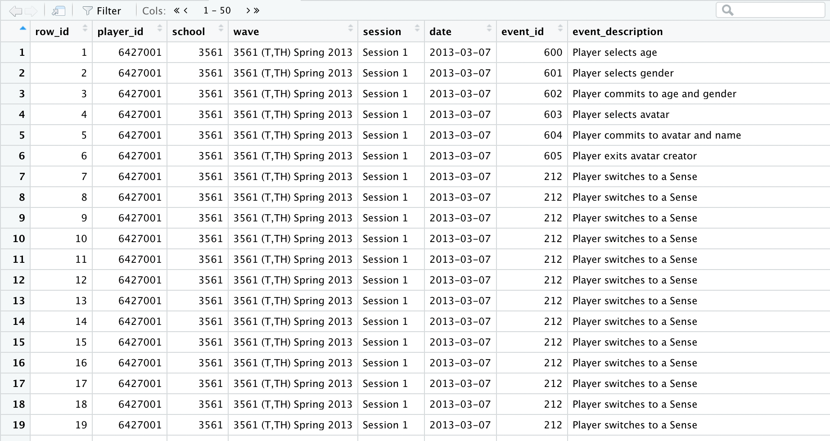
Calculating average time spent on session by each players
Data Preparation

Slide 7
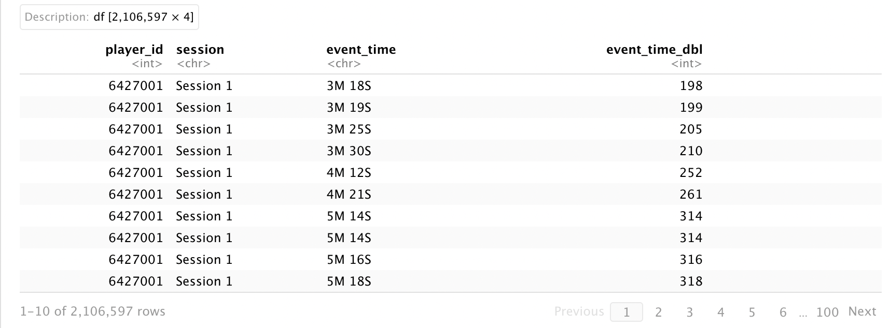
Calculating average time spent on session by each players
Data Preparation

Slide 8
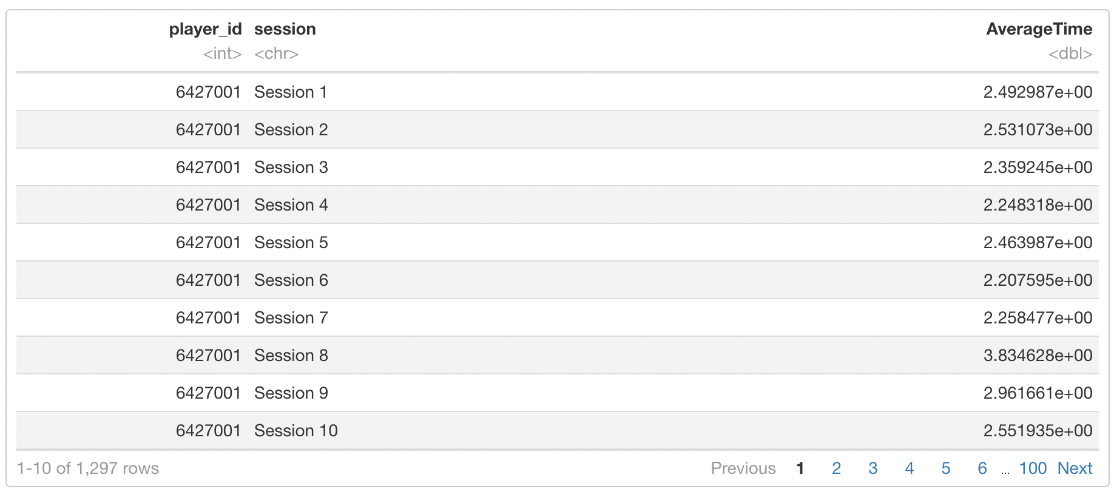
Calculating average time spent on session by each players
Data Preparation

Slide 9
Data Exploration

Slide 10
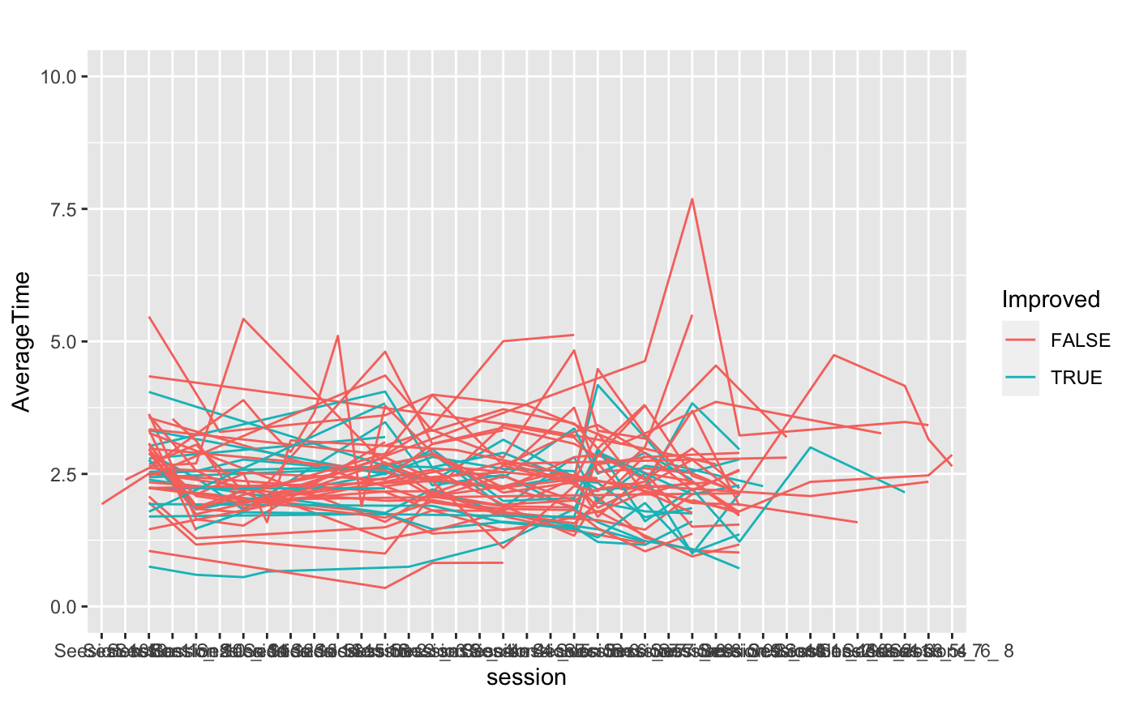
Data Exploration

Slide 11
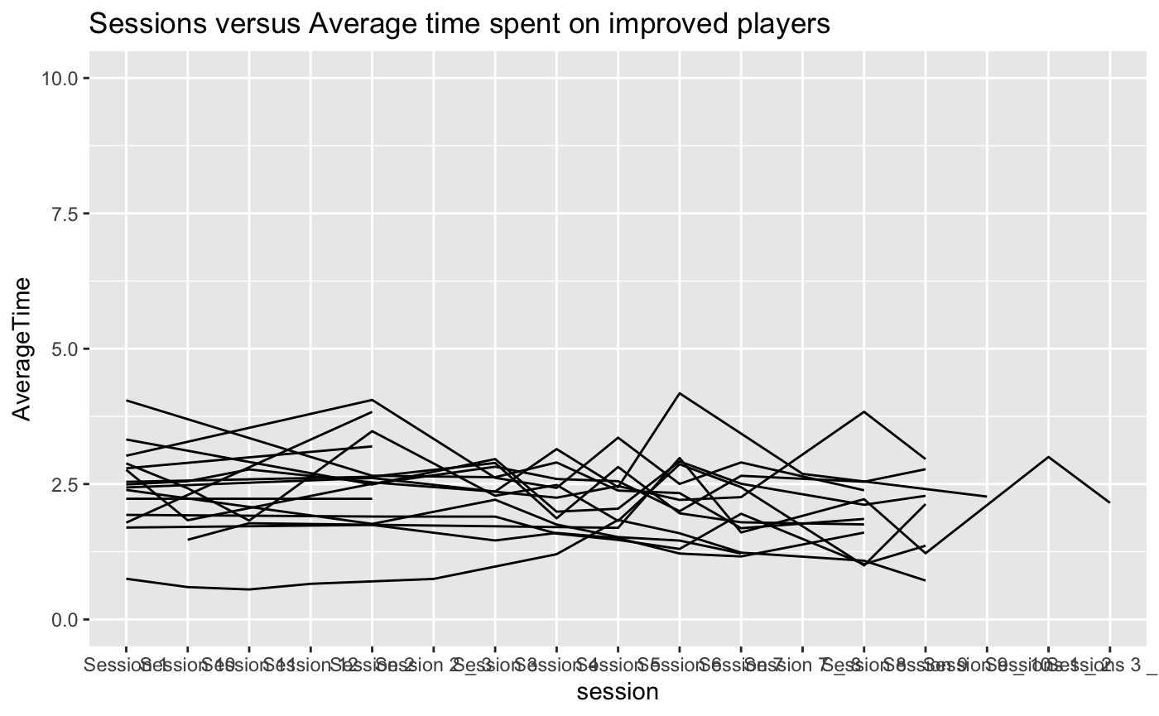
Data Exploration

Slide 12
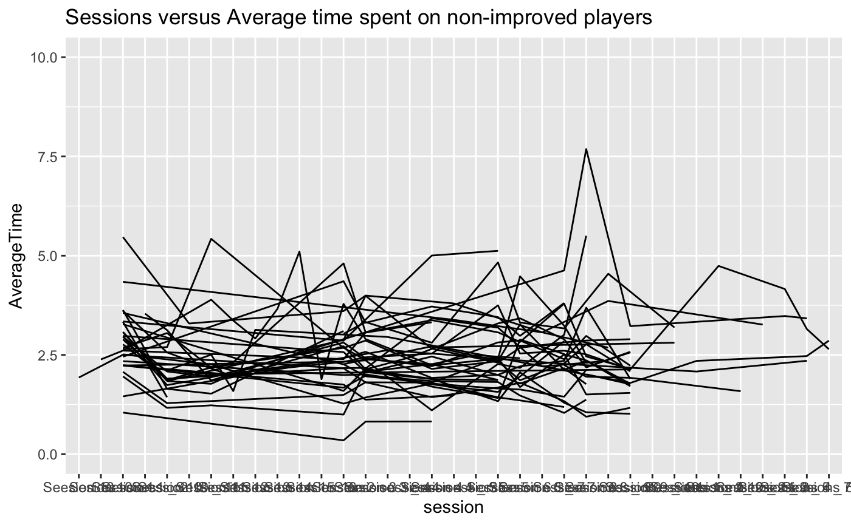
Data Exploration

Slide 13
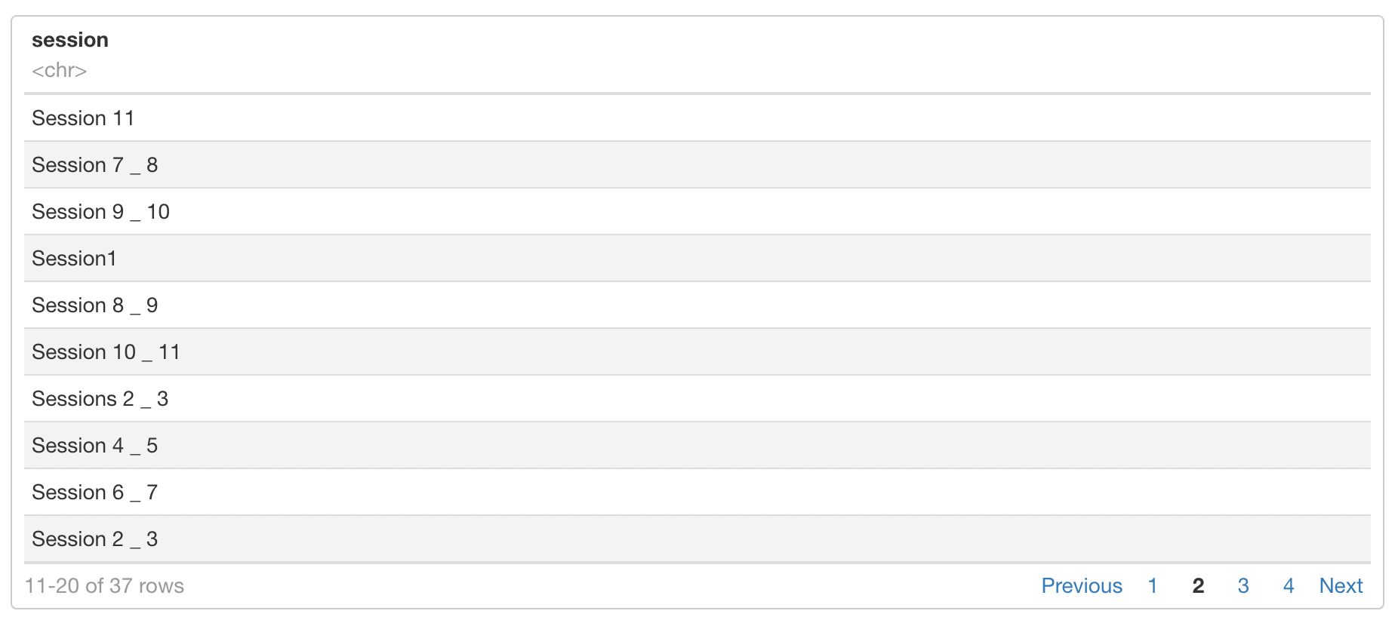
Data Exploration

Slide 14
Data Cleaning

Slide 15
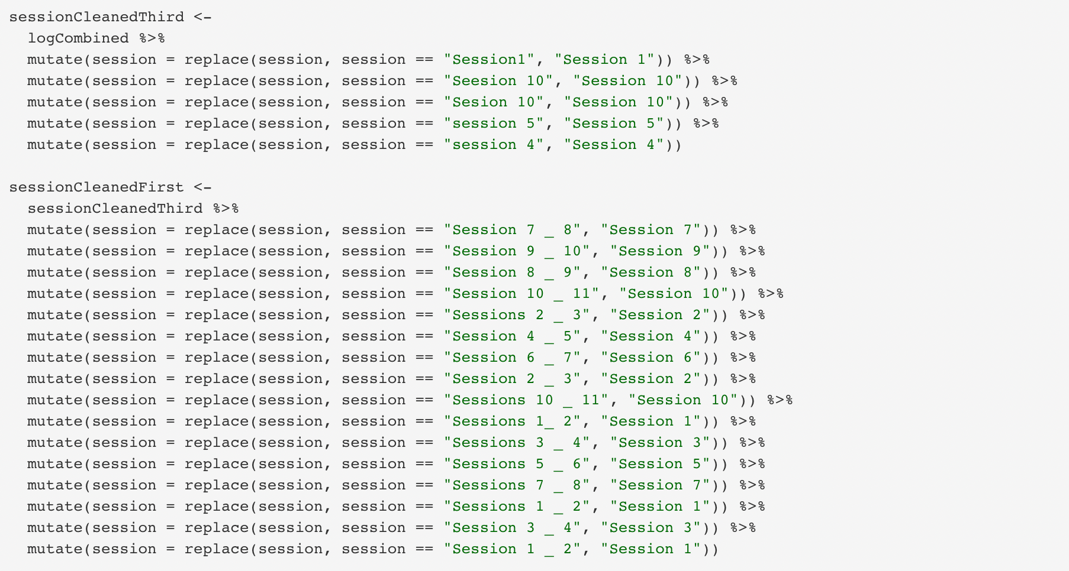
Data Cleaning

Slide 16
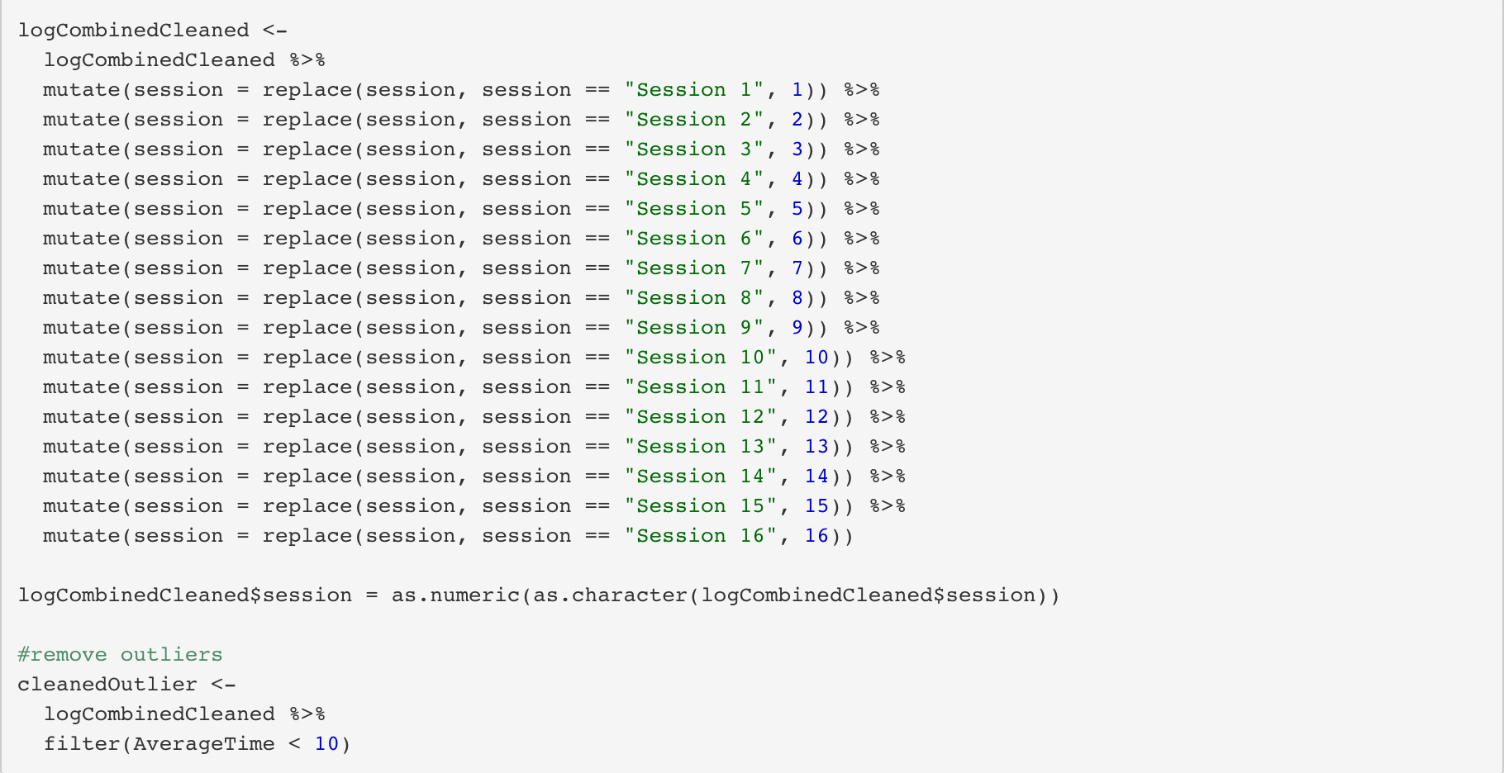
Data Cleaning

Slide 17
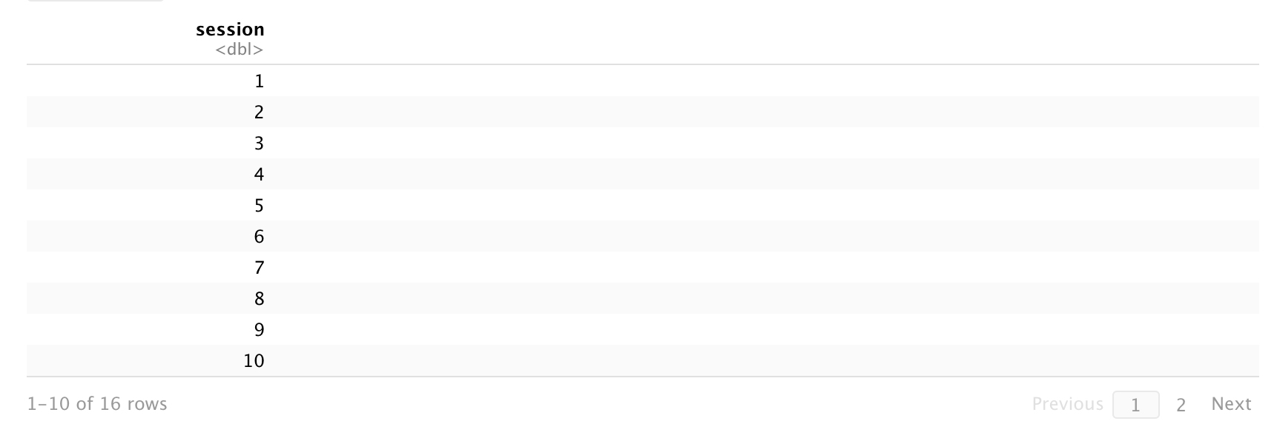
Data Cleaning

Slide 18
Visualization

Slide 19
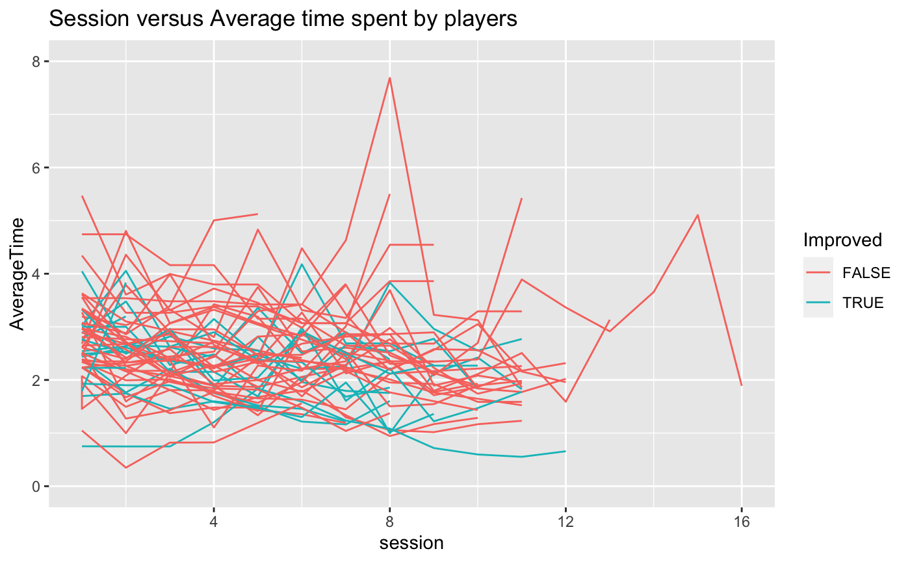

Slide 20
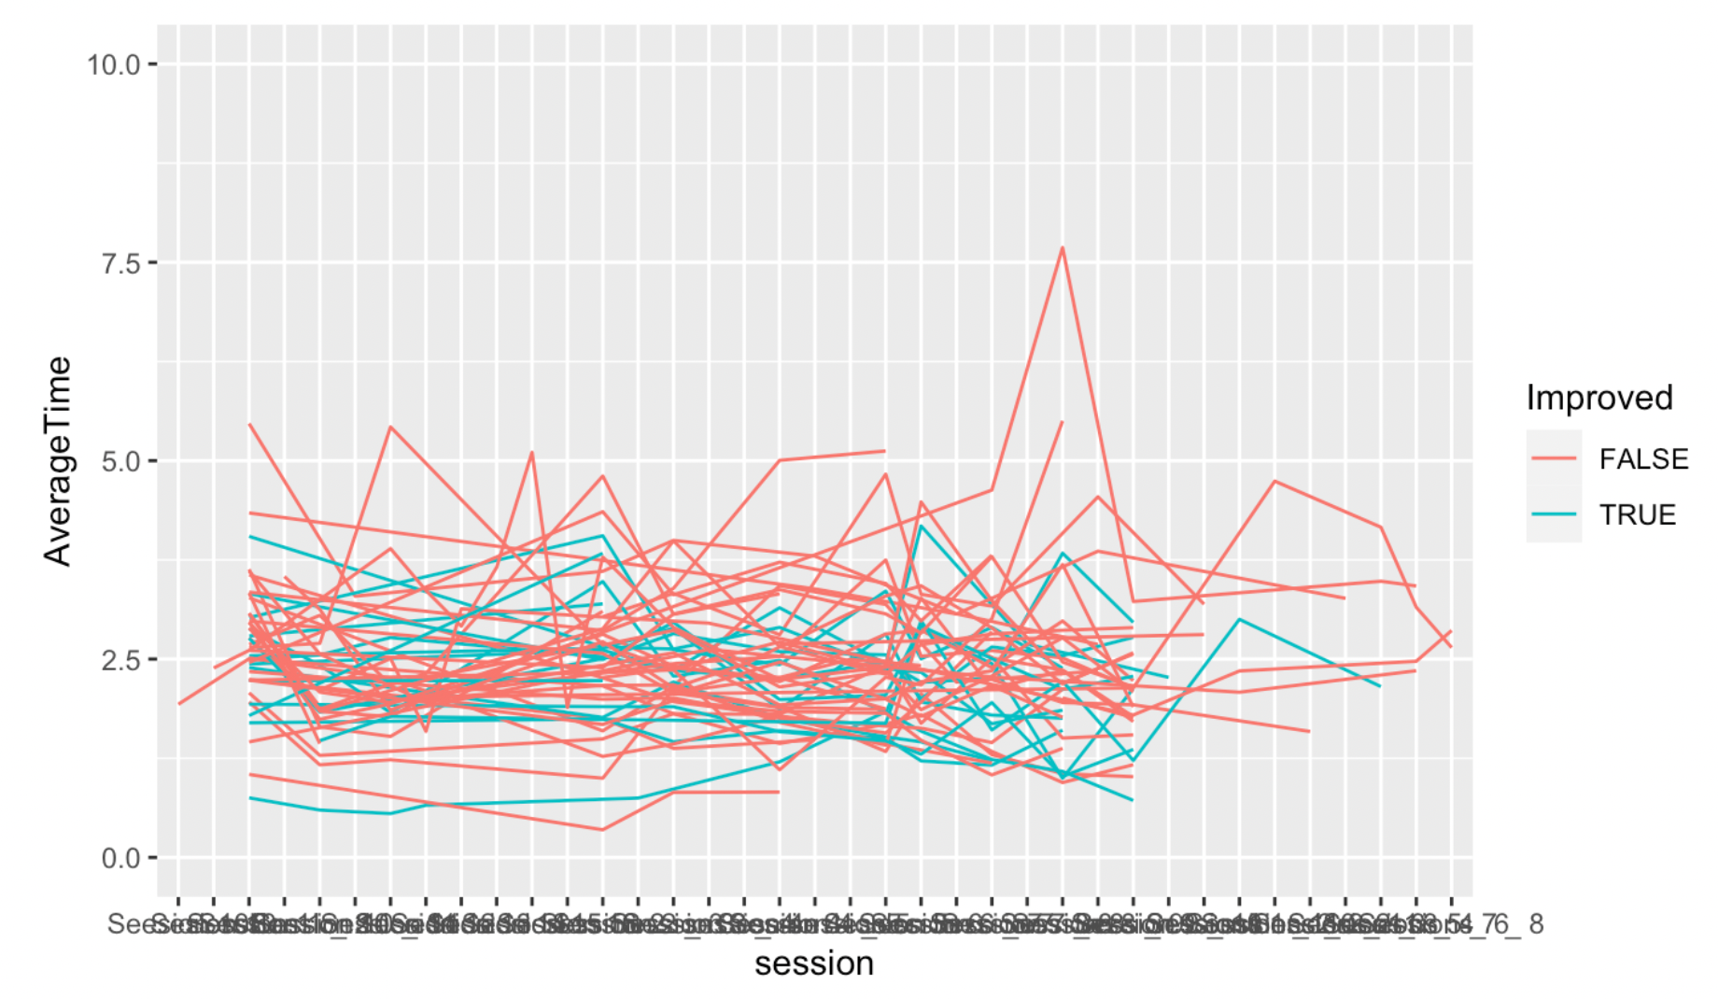
Previous unclean data

Slide 21
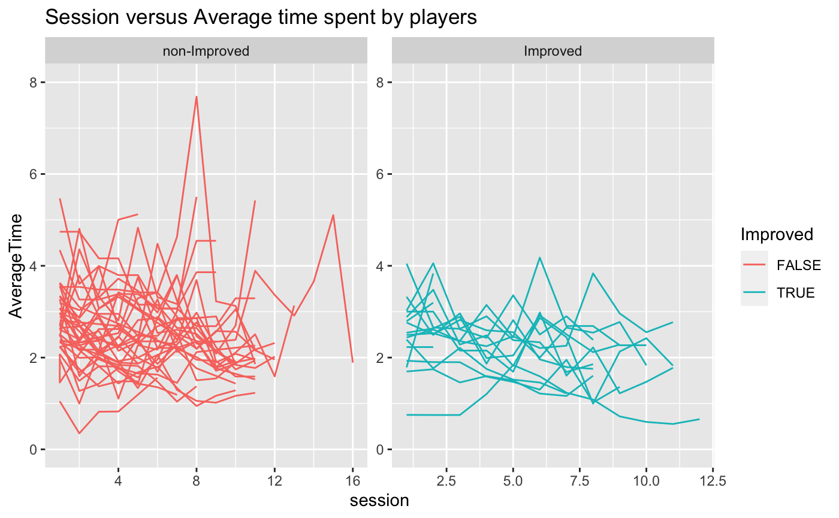

Slide 22
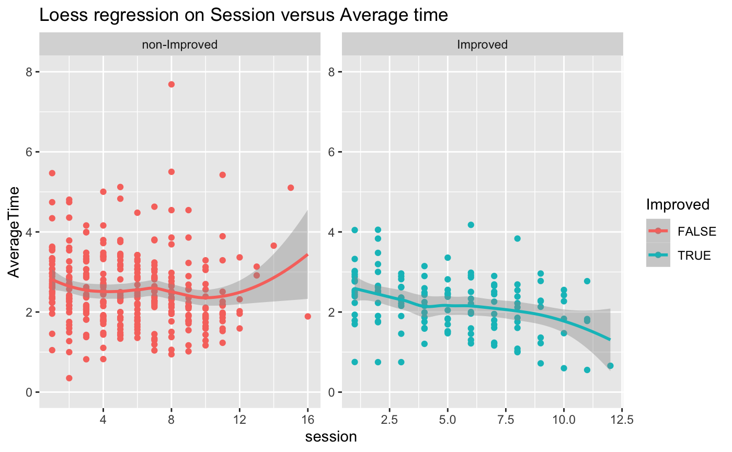

Slide 23
Checking Statistical Significance

Slide 24
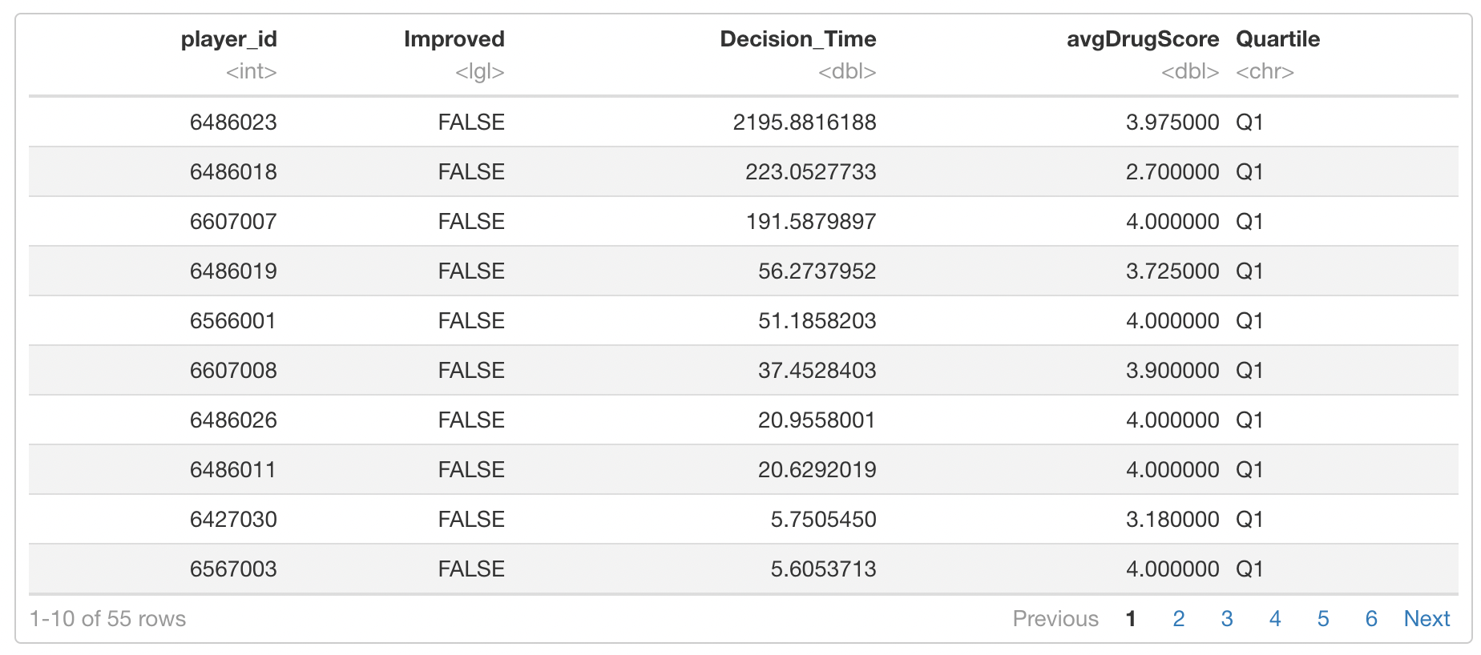

Slide 25
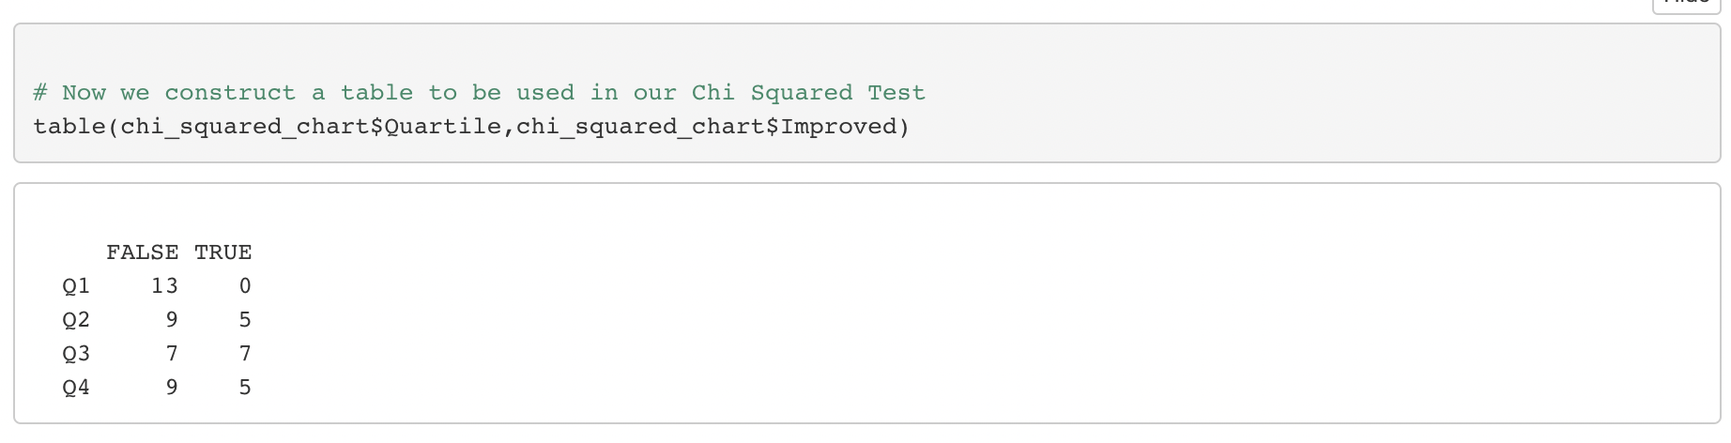
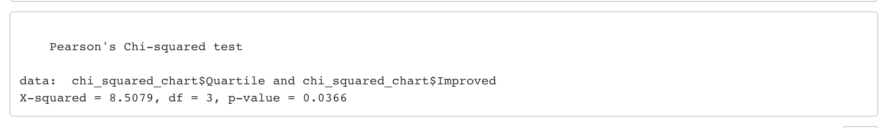

Slide 26
Summary
Students actively participate in the game play provided through the Play2Prevent platform, their scores on the Drug Resistance Survey improve
This implies that the platform is able to prevent at risk adolescents from participating in self-destructive behavior.

